Slide 1

Forex Pair Price Prediction with Machine Learning
DS105 Final project proposal

Slide 2

Problem Statement
Forex Pairs Price Prediction with Regression Supervised Machine Learning based EURUSD.

Slide 3

Overall Approach to the Problem
Sourcing of reliable and consistent dataset
Data exploration and pre-processing
Feature Engineering
Data Visualization
Regression Models Training
Regression Models Evaluation and Selection
Apply the Selected Regression Model

Slide 4

1. Sourcing of reliable and consistent dataset
MetaTrader 4, also known as MT4, is an electronic trading platform widely used by online retail foreign exchange
for speculative traders.
It was developed by MetaQuotes Software and released in
2005. The software is licensed to foreign exchange
brokers who provide the software to their clients.

Slide 5
Datasets
Hourly price data for EURUSD from Apr 2011 to Mar 2021 (10 years), each pair about 62,000 rows of data.
Source of the data: MetaTrader 4 (MT4).
Link to the data:
https://github.com/joeyh28/DS10105-Project.git

Slide 6
Original Dataset Information
For the Forex Pair, the raw dataset consist of the following columns:
Date - Date of the transaction record
Time – Opening/Starting time of the transaction record
Opening – Opening price of time period
High – Highest recorded price within the time period
Low – Lowest recorded price within the time period
Close - Closing price of the time period
Volume – Transacted volume within the time period

Slide 7
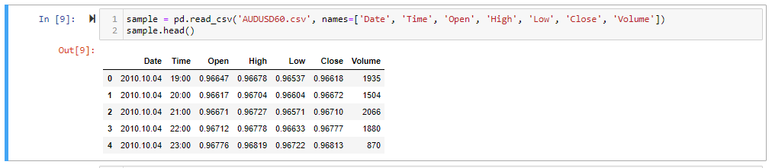
Dataset Sample
Example of the dataset:

Slide 8
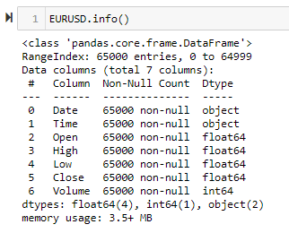
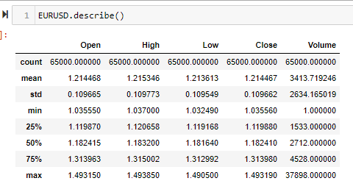
2. Data Exploration and Pre-processing
Ensure there is no empty cell in the dataset
Understand the data type

Slide 9
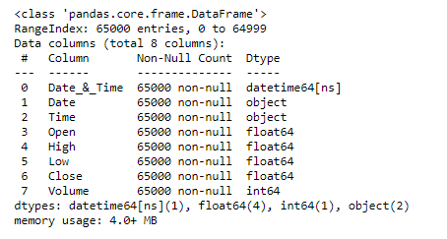
2. Data Exploration and Pre-processing
Combining the Date & Time columns to form a single Date&Time column and convert to datetime format

Slide 10
3. Feature Engineering
20 additional Features derived from the original dataset, which included:
Simple Moving Average, 9, 12 and 24 periods
Exponential Moving Average, 9, 12, 13, 26 periods and MACD indicator..
Rolling Minimum and Maximum price for past 12 and 24 periods.
OpenVSClose, HighVSLow, Close_VS_exClose, Open_VS_exOpen
Average price of High and Low price for current period
Trading Volume related – Price Momentum
Bull and Bear Power indicator

Slide 11
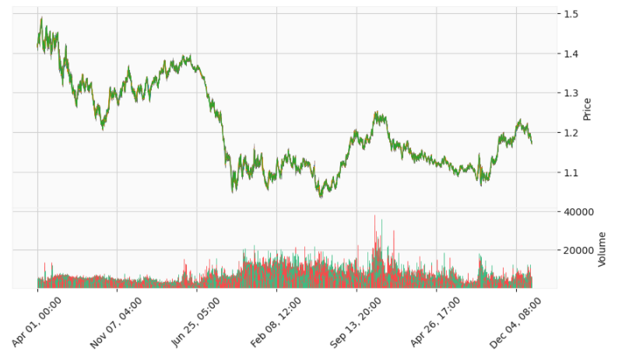
4. Visualization of the Dataset
Candle stick Plot, OCHL

Slide 12
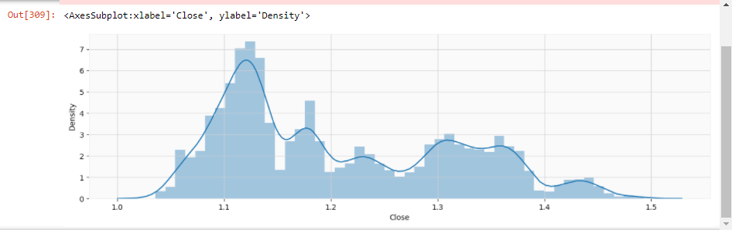
4. Visualization of the Dataset
Distribution Plot

Slide 13
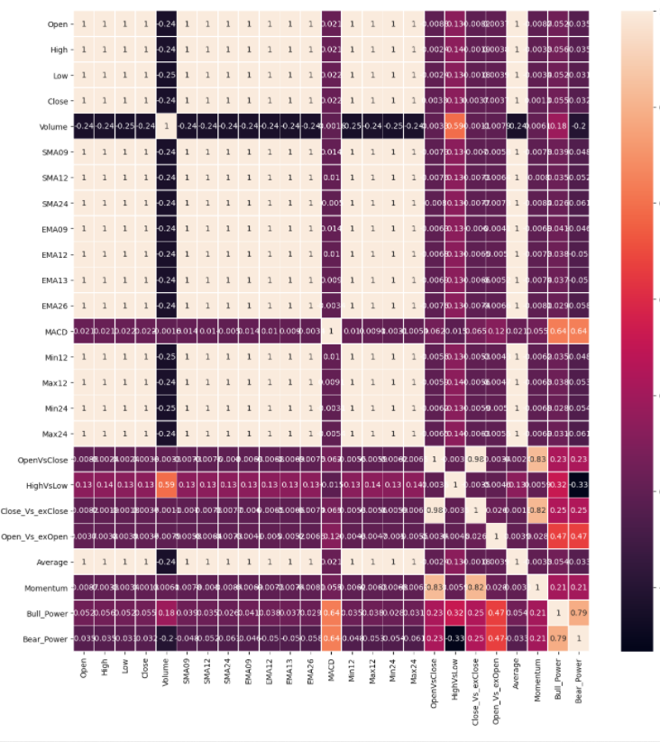
4. Visualization of the Dataset
Heatmap Plot of Correlation

Slide 14
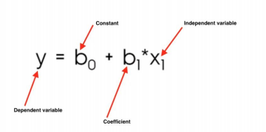
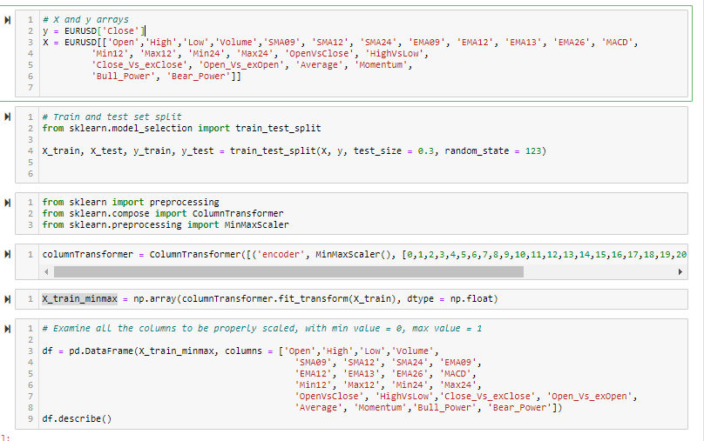
5. Regression Models Training

Slide 15
6. Models Evaluation and Selection
The prediction is done with the following linear models library imported from sklearn:
Linear Regression
Ridge Regression
Lasso Regression
Elastic Net Regression
Polynomial Regression
Robust Regression

Slide 16
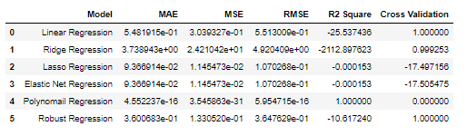
6. Models Evaluation and Selection
Summary of Evaluation
MAE: Mean Absolute Error
MSE: Mean Square Error
RMSE: Root Mean Square Error

Slide 17
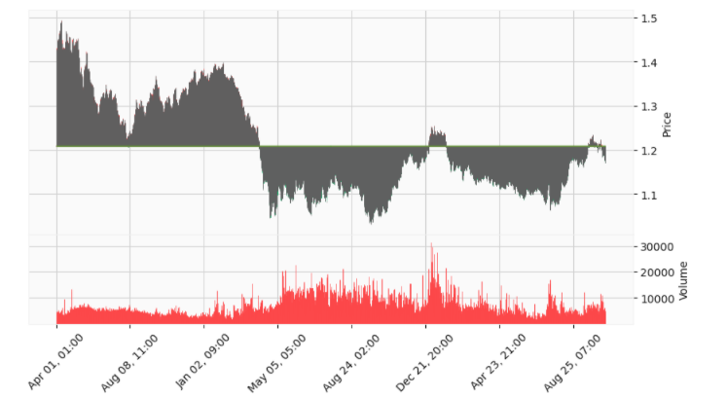
7. Applying the Selected Regression Model

Slide 18
8. Limitation and Future Improvement
Examine and improve the prediction result.
Include Classification Machine Learning like logistics regression
To extent the prediction model to link up with live trading system like MT4 to enable live price prediction and trading.

Slide 19
End

